Slide 1
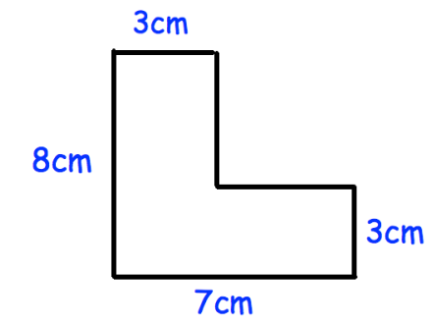
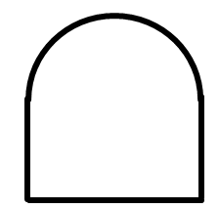
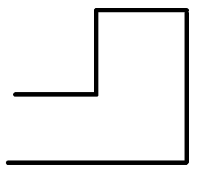
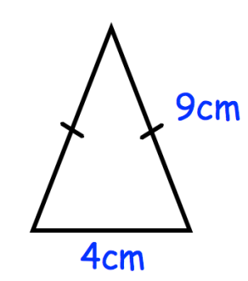

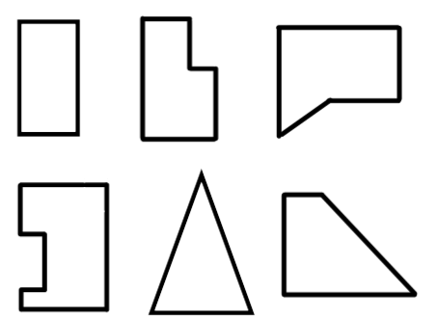
Subtopic N2.13 – Perimeter of Compound Shapes
LEARNING OUTCOME: to solve problems involving the perimeter of compound shapes
Objectives:
Keywords:
Compound
Edges
Length
Units
To identify a compound shape.
To find missing lengths in a compound shape
To find the perimeter of a compound shape
Introduction – Read and annotate:
A compound shape is made by joining two or more simple shapes together. When exploring their
perimeter, the focus is on the outer edges, as the perimeter measures the total distance around the
outside of the shape.
Definition
Characteristics
Any shape that is made up of two or more geometric shapes.
If we know the lengths of the sides of a compound shape, we can find the perimeter, which is the total distance around the outside.
Examples
Compound shape
Non - Examples
Note: we will focus on finding perimeters of shapes made from rectangles
Identify a compound shape
Example 1 - I do…
Example 2 – We do…
Example 3 – You do…
Steps | Tick the compound shape | Tick the compound shape | Tick the compound shape
Check whether the shape is made up of geometric shapes
Independent Practice
1. Tick all the compound shapes.
2. Fill in the blanks.
Perimeter is the _________ around the outside of a 2D shape.
To find the perimeter we _______ all the side lengths.
distance
add

Slide 2
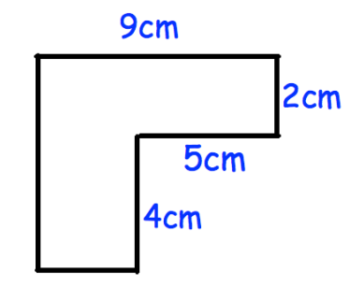
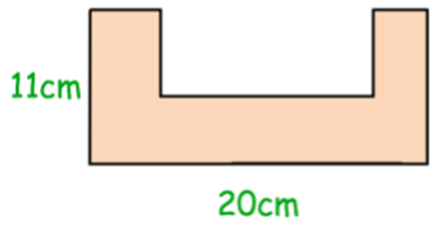
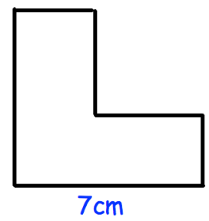
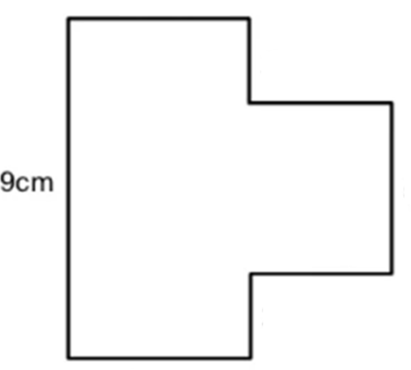
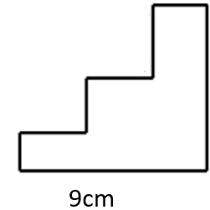
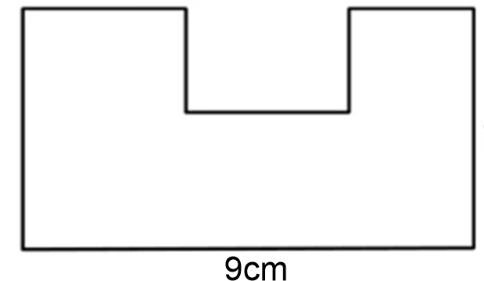
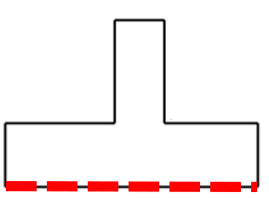
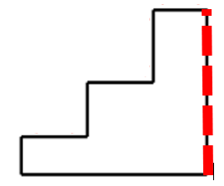
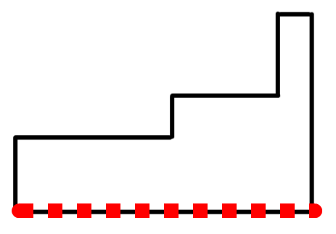
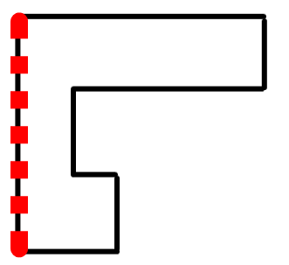
Develop strategies for finding missing edges in a compound shape
Example 4 - I do…
Example 5 – We do…
Example 6 – You do…
Steps | Highlight the two shorter edges that must sum to 9cm | Highlight the three shorter edges that must sum to 20cm | Highlight the two shorter edges that must sum to 7cm
Look for edges that sum to a given edge.
Independent Practice
Highlight the 3 shorter edges that must sum to 9cm
a) b) c)
4. Highlight the edges that must sum to the same length as the broken edge on each diagram.
a) b)
c) d)

Slide 3
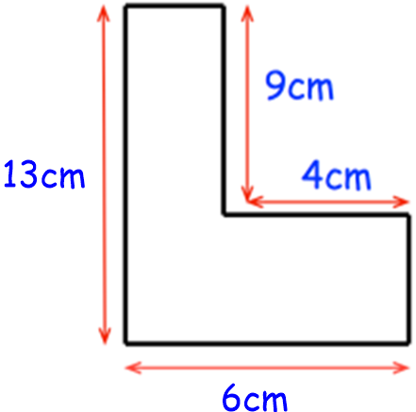
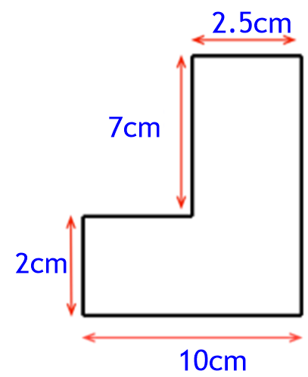
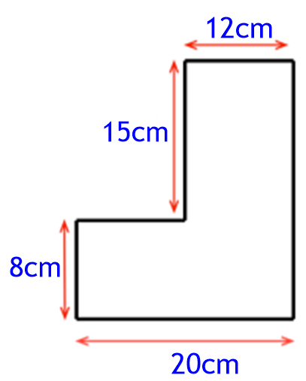
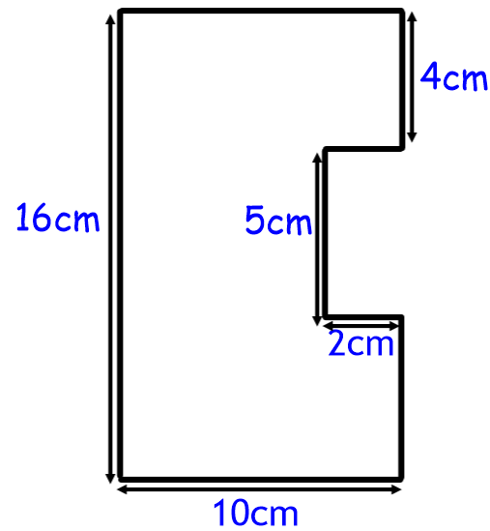
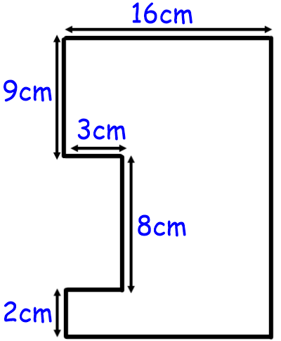
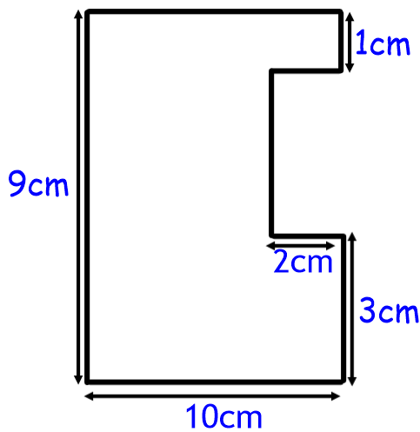
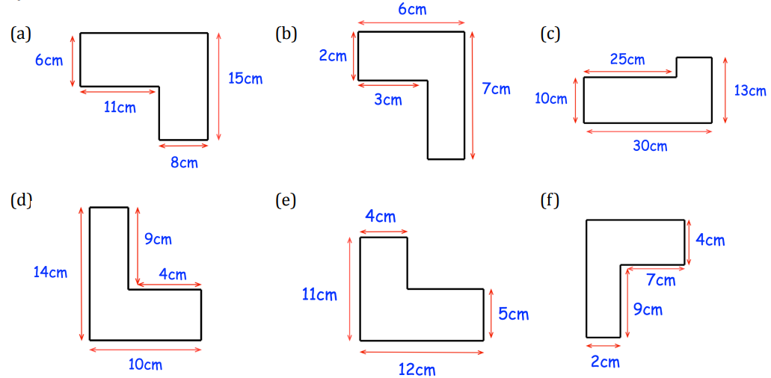
Example 7 - I do…
Example 8 – We do…
Example 9 – You do…
Steps | Add all the missing lengths to the diagram | Add all the missing lengths to the diagram | Add all the missing lengths to the diagram
1. Look for sides that combine to make the missing length
2. Add or subtract to find the missing length
2cm
7.5cm
9cm
8cm
23cm
4cm
10cm
10cm
2cm
2cm
5cm
19cm
7cm
3cm
16cm
Independent Practice
5. Fill in the missing side lengths on each diagram.
19cm
5cm
3cm
9cm
5cm
3cm

Slide 4
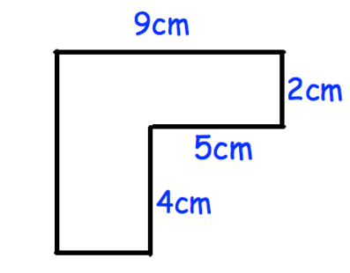
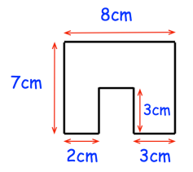
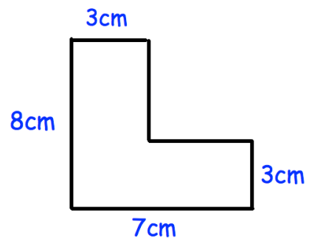
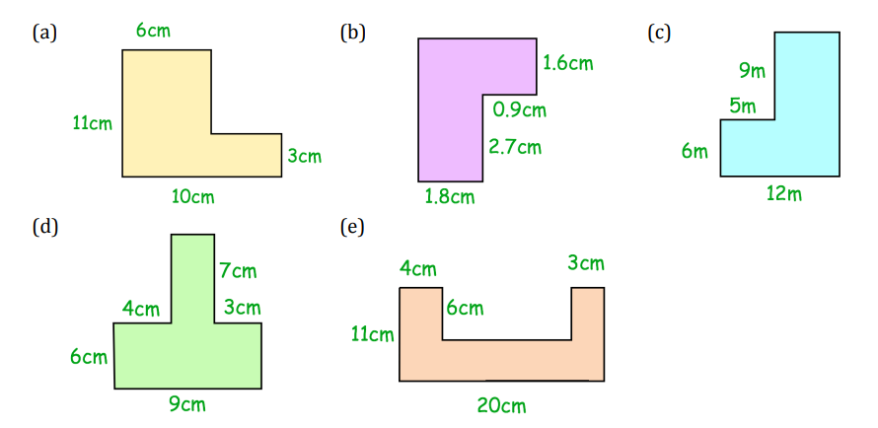
6cm
9cm
6cm
13cm
5cm
8cm
Find the perimeter in a compound shape
Example 10 - I do…
Example 11 – We do…
Example 12 – You do…
Steps | Find the perimeter of this shape | Find the perimeter of this shape | Find the perimeter of this shape
Find all the missing lengths on the outside of the shape
Add all the side lengths to find the perimeter
30cm
36cm
30cm
Independent Practice
6. Find the perimeter of each shape below.
42cm
14cm
54cm
‹#›

Slide 5
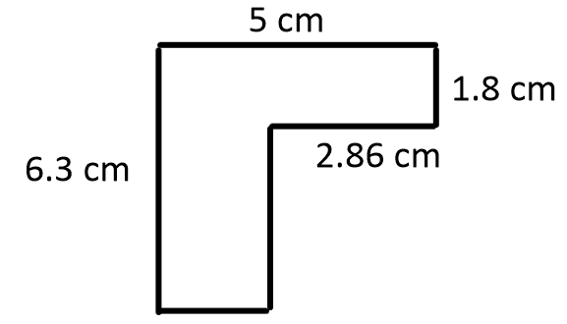
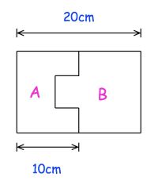
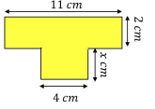
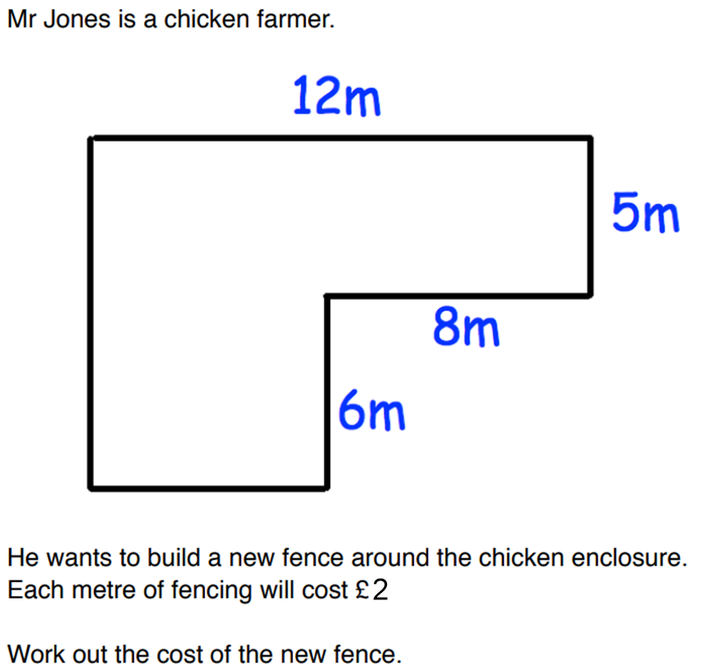
7. A rectangle is divided into two shapes, A and B. Which of these statements is true? a) The perimeter of A is greater than the perimeter of B b) The perimeter of A is less than the perimeter of B c) The perimeter of A is the same as the perimeter of B
8. The perimeter of the shape is 31cm. Find the missing length x. 6cm
9.
(f)
44cm
74cm
22.6cm
£92
‹#›

Slide 6
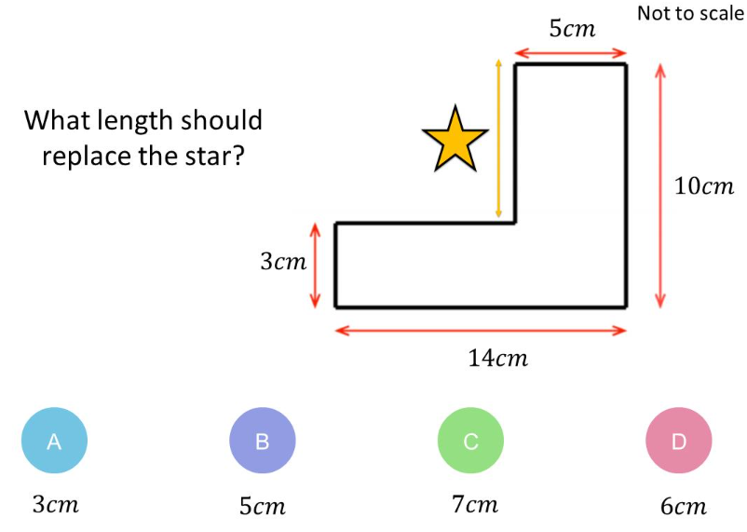
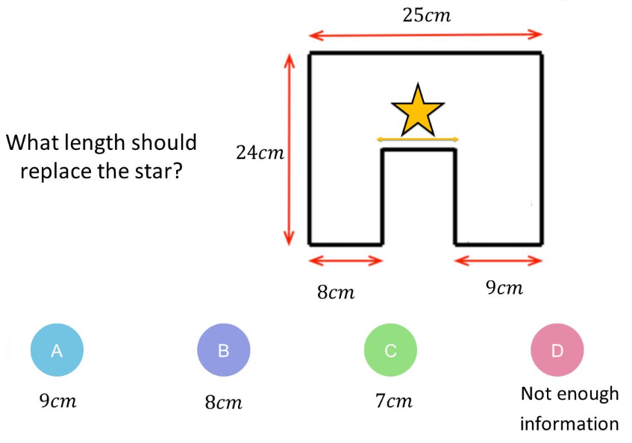
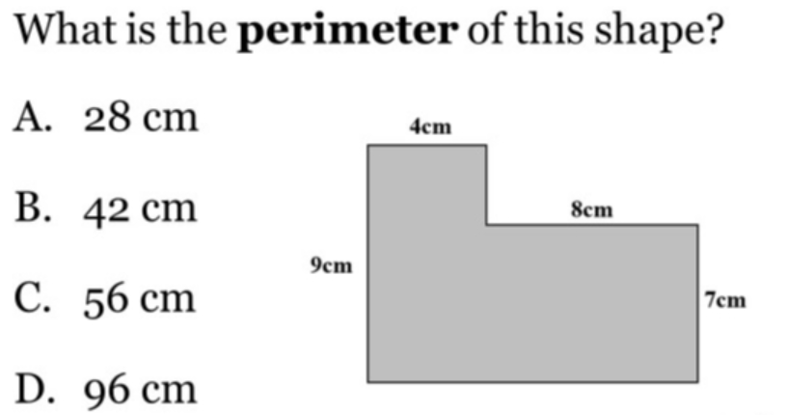
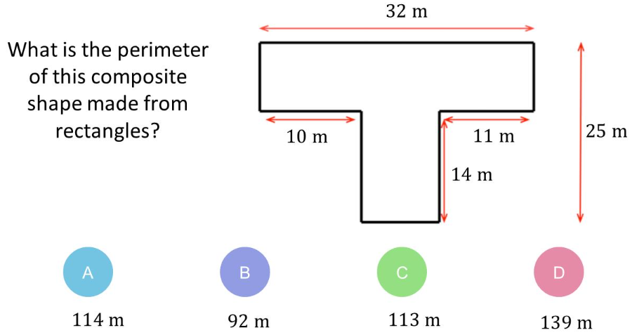
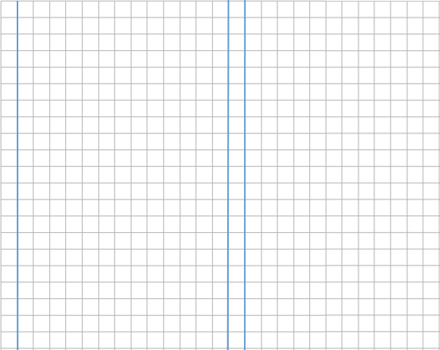
Skills Check
1. 2.
3. 4.

Slide 7
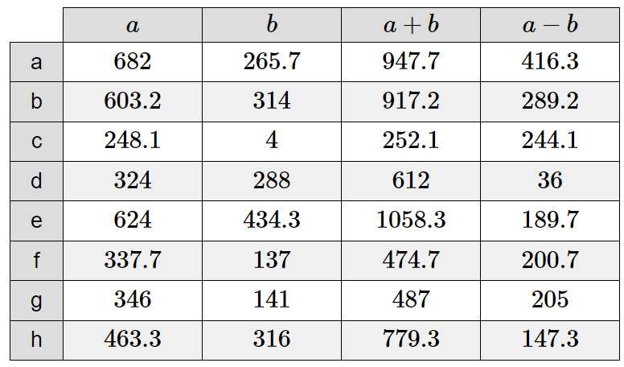
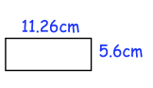
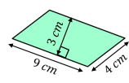
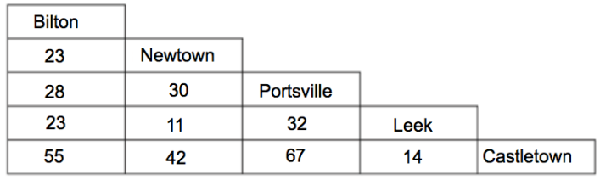
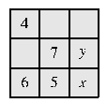
Method Selection
Mixed Fluency
Grace is saving money for a new guitar. The guitar costs £175. In January, she saved £36.24. In February, she saved £14.17. Work out how much more money Grace needs to save. £124.59 | Calculate the perimeter of the following shapes: 33.72cm 26cm
The table below shows the distance in miles between some cities. James drives from Newtown to Castletown. He then drives from Castletown to Bilton. He then drives from Bilton to Leek. Work out the total distance travelled. 120 miles
Unfamiliar Contexts
A train carriage has 80 seats. On my journey I noticed that all the seats in my carriage were taken and 7 people were standing. At Banbury, 9 people left the carriage, 28 people entered it and all seats were taken. How many people now had no seat? 26. Before Banbury, 7 people were standing. After 9 people left the carriage, there would be 2 spare seats and no one standing. After 28 people entered, the two seats would be taken and 26 people left standing.
The diagram shows a partially completed magic square, in which all rows, all columns and both main diagonals have the same total. What is the value of x + y? 13. 6 + 7 + top right square = x + y + top right square. Therefore x + y = 6 + 7 = 13.
‹#›

